Slide 1

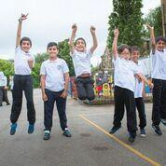
Paradise Primary School
Prospectus 2023-2024

Slide 2
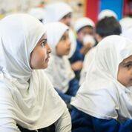
Headteacher’s Welcome Message
Assalamualaikum and Welcome to Paradise Primary.
First of all thank you for your interest in our school. This prospectus is designed to give you the necessary information about the school and, it is hoped, will answer any questions or concerns that you may have. However, please bear in mind that no prospectus can take the place of a visit or personal contact and we welcome you to come and meet us and have a look around our setting.
We have come a long way and achieved so much since we opened in 1998 when we started with 8 children attending nursery on a part time basis. In the early days we were based in an old temporary modular building but today we have over 200 children of 12 different nationalities and have moved to larger premises offering high quality education from 2 year olds in early years through to 11 year olds in our primary school.
Paradise Primary School has established a name for itself for providing high quality education where Islamic values and etiquettes are practiced.
At Paradise we are proud to be a school committed to providing students with the highest quality, academic and character building education; wherein staff and pupils are happy to work together for the success they achieve.
We are dedicated to nurturing spiritual growth and developing God conscious students through our positive Islamic teachings. The school aims to create a safe and nurturing environment that stimulates intellectual thought and independence.
We also place a high level of importance on working with parents to create an ideal learning environment and are committed to working with you to achieve our goals.
Mrs Hafsa Patel Head teacher.

Slide 3
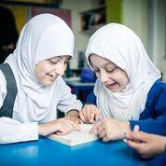
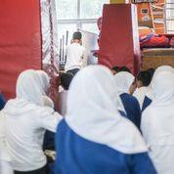
“Oh my Lord! Increase me in knowledge” (20:114)
Introducing Paradise Primary School: In the pursuit of excellence
At Paradise we provide a warm, safe, happy and consistent learning environment. Here, we pursue excellence in all areas, academic, emotional, social and physical to aid our children to fulfil their potential.
We are proud to have the opportunity to do this in an Islamic environment which we feel has a positive impact on the social and moral attitudes of our children and also to offer a broad and balanced curriculum to achieve diversity in their learning.

Slide 4
Our Aims
Create a caring and nurturing environment where each child is equally valued and treated as an individual so that they can become strong academically, spiritually and are able to contribute to society as good well-rounded individuals with excellent manners and respect for all;
Instil shared British values, including democracy, rule of law, individual liberty and mutual respect and tolerance towards people of all faiths and none;
Develop children who are confident and comfortable with their Muslim identity, ethnicity and are able to play an active role in contemporary British society;
Deliver high quality and inspirational teaching within a curriculum that is based on high aspirations that encourages and rewards high attainment and diligence in equal measure;
Meet the social, physical, emotional and spiritual needs of all children and their families within a holistic framework thus developing well-balanced responsible children;
Incorporate activities to stop local children from feeling isolated;
Break the cycle of deprivation by promoting the importance of education and skills, in partnership with parents and other likeminded groups.

Slide 5
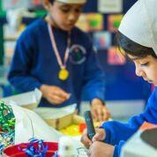
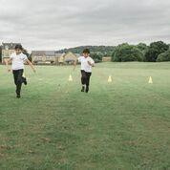
Our Vision
Preparing our children for living in 21st century Britain by imparting fundamentals of mutual respect, integrity and continuous improvement. To be proud of their Muslim identity and to use all these values to contribute positively to society as equal British Citizens.
Our Ethos
Underpinning all our work is the Islamic ethos which runs through the entire school from early years through to year 6 in primary.

Slide 6

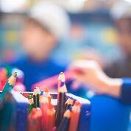
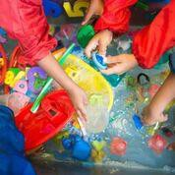
Who Can Attend?
Children can start our Early Years Unit as young as 2 years old. The Early Years Unit receives government funding for 3-5 year olds and for eligible 2 year olds also.
A number of 2 year olds can attend our unit in a private paying capacity should they wish.
In the Primary School we offer places to children in Years 1- 6 (5-11 years old). Paradise Primary School is registered with the Department for Education as an independent school so fees will apply throughout this stage.
Places are open to both boys and girls in all stages at the school.

Slide 7
Admissions
We anticipate all applicants to give their commitment, respect and wholehearted support to uphold and maintain our school ethos and vision.
This does not affect the right of parents who are not of the faith of this school to apply for and be considered for a place.
As our school is an independent school, the following criteria will be enforced to determine allocation of place.
To parents that are new to the school and in the case of number of applications exceeding the number of places available, priority will be given;
•
•
•
•
To children whose siblings attend the school On a first come, first serve basis
Whether the child lives locally
Due to popular demand for Early Years places we recommend you apply for a nursery place before your child’s first birthday.
The level of parental engagement
Should you wish to apply for a place at our school you can do so on the website or by contacting the school for an application form.

Slide 8
Admissions Stages
There are three separate admission stages – Nursery, Reception and KS2 (Year 3). The maximum numbers of pupils in each of these stages differ, and as we are an independent
The methods used to quantify the criteria will include:
Data from EEMS (School information management
system), KS1 results, tracker progress, teacher
school, our admissions criteria will be enforced to assessments, planners, certificates, signing in
determine allocation of places.
The nursery admissions criteria will follow the process as outlined above, the admission to Reception and Year 3 are as follows.
In the case of number of applications exceeding the number of places available points will be given to each applicant based on:
sheets for parents’ evenings, forums and other school activities.
Total points will be used to determine places in each of the three areas outlined above. The weighting of points in each of these areas can be obtained by contacting the school.
•Parental engagement
•Siblings (past and present)
•Attainment
•Attendance
•Attitude to learning
•Behaviour
•Catchment area
If a child is withdrawn from the list, an allocated place is refused or a child is withdrawn halfway through the academic year, he/she will be put at the back of the waiting list, and minus points will be assigned to that application.

Slide 9
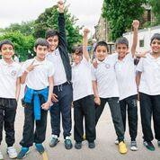
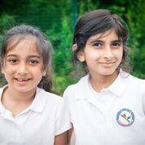
Mid-Year Admissions
Children will be admitted to the school at any age or at any time of the year, subject to the availability of a place and the child meeting the required attainment levels and admission criteria at the relevant time. Places will only be offered subject to;
Successfully passing entry test
School Report being obtained from previous setting
Interview with members of the Governing Body.

Slide 10
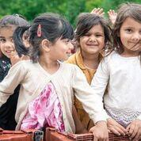
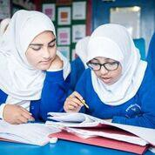
Fees
The annual fee for children attending full-time is £3240 for your first child and £3060 for any additional children.
This is due at the beginning of the school year. All cheques should be made payable to Paradise Primary School.
The school receives funding for children between the ages of 3-5. The school will inform you if your child is eligible.
For current playgroup and full day fees please contact the school. We will inform you when the fees are due. Payment can be made in cash or cheque. Payment of the fees will be due within 10 working days of the invoice. Once playgroup days/sessions are booked by parents and confirmed by the school, parents will not be refunded for any changes they wish to make in the contractual term time.

Slide 11
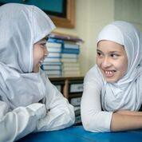
Staff & Curriculum
The school endeavours to employ experienced teaching staff and classroom assistants in order to impart the best possible education to the pupils but our development program for new teachers is strong and this has been recognised at every inspection. The development of our teaching staff is ongoing throughout the years. The quality of our teaching is monitored on a regular basis and is evident in our high academic achievements.
The curriculum is all the planned activities which we organise in order to promote learning and personal growth and development. It includes not only the formal requirements of the National Curriculum, but also the curriculum guarantees we as a school provide the learning to develop the independence and responsibility of all of our pupils. We ensure that all children have a broad, balanced and relevant education which provides continuity and progression and takes individual differences into account. We aim to teach our pupils how to grow into positive, responsible people, who can work and co-operate with others while developing knowledge and skills, so that they achieve their full potential.

Slide 12
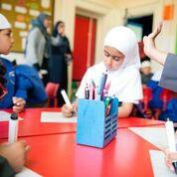
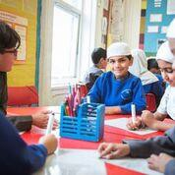
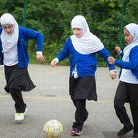
Staff & Curriculum
Paradise will develop the children spiritually, morally, socially and culturally and encourage our children to implement these values in their daily lives.
The curriculum is designed to fulfil our vision and ethos; to produce children with the confidence, skills and knowledge to be prepared for life in 21st Century Britain.
General subjects offered include Literacy, Numeracy, Science, Design Technology, Information Technology, Physical Education and Art/Crafts. We also offer Arabic language and Religious Education and throughout integrate SMSCD (spiritual, moral, social and cultural development). Music is also taught through nasheed.

Slide 13
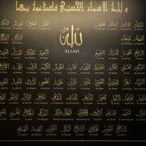
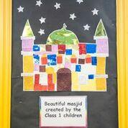
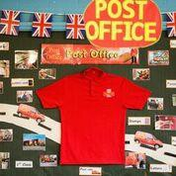
SMSCD
As mentioned previously this is the Spiritual, Moral, Social and Cultural Development of the children which fits strongly with our ethos. This includes the teaching of:
right from wrong,
responsibilities at school, home and society,
respect for British law and democracy,
awareness of British institutions
This also promotes the opportunity for self-exploration, discovery, opinions and debates.
We encourage parents to get involved at home with these areas by promoting tolerance, independence and extra-curricular interests, as well as developing the child as an active British citizen and a positive Islamic role model for the community.

Slide 14
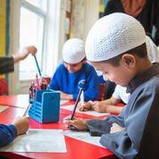
Assessment
Our school considers accurate and focused assessment as the cornerstone of high quality teaching, as it allows learning to be planned and taught accurately as well as meeting the needs of the requirements of the children and ensuring high levels of expectation and support.
A pupil’s progress throughout the subjects of English and Mathematics are assessed by teachers throughout each year using APP (Assessing Pupil’s Progress) guidance, this is reported to parents in a written report during the summer term of each school year, and at parental consultations. Pupil progress meetings are held termly between class teachers and members of the schools leadership team.
In Key Stage 1 children have their performance formally monitored through teacher assessments and tasks and levels of attainment are subsequently recorded and reported. Pupils in Years 3, 4 and 5 also undertake the optional tasks to allow teachers to further monitor progress and the school monitors progress against national standards. Year 6 also have their performance formally monitored through standardised testing and levels of attainment are reported and recorded.

Slide 15
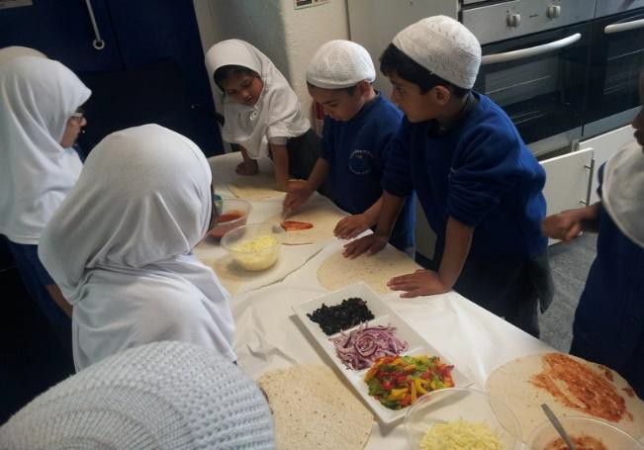
Extra- Curricular
At Paradise we offer a range of clubs which change every term.
These run at lunch times and after school currently and are very popular with the children.
Children are informed of the upcoming clubs in assemblies, then letters are sent out to the parents and places are filled on first come, first served basis and the remainder will form a waiting list. We aim to give all children an opportunity to attend a club so the waiting list is automatically guaranteed a place the following term.
Range of clubs are dependent on the time of year and subjects may vary. Visit the website to get a list of our current clubs.

Slide 16
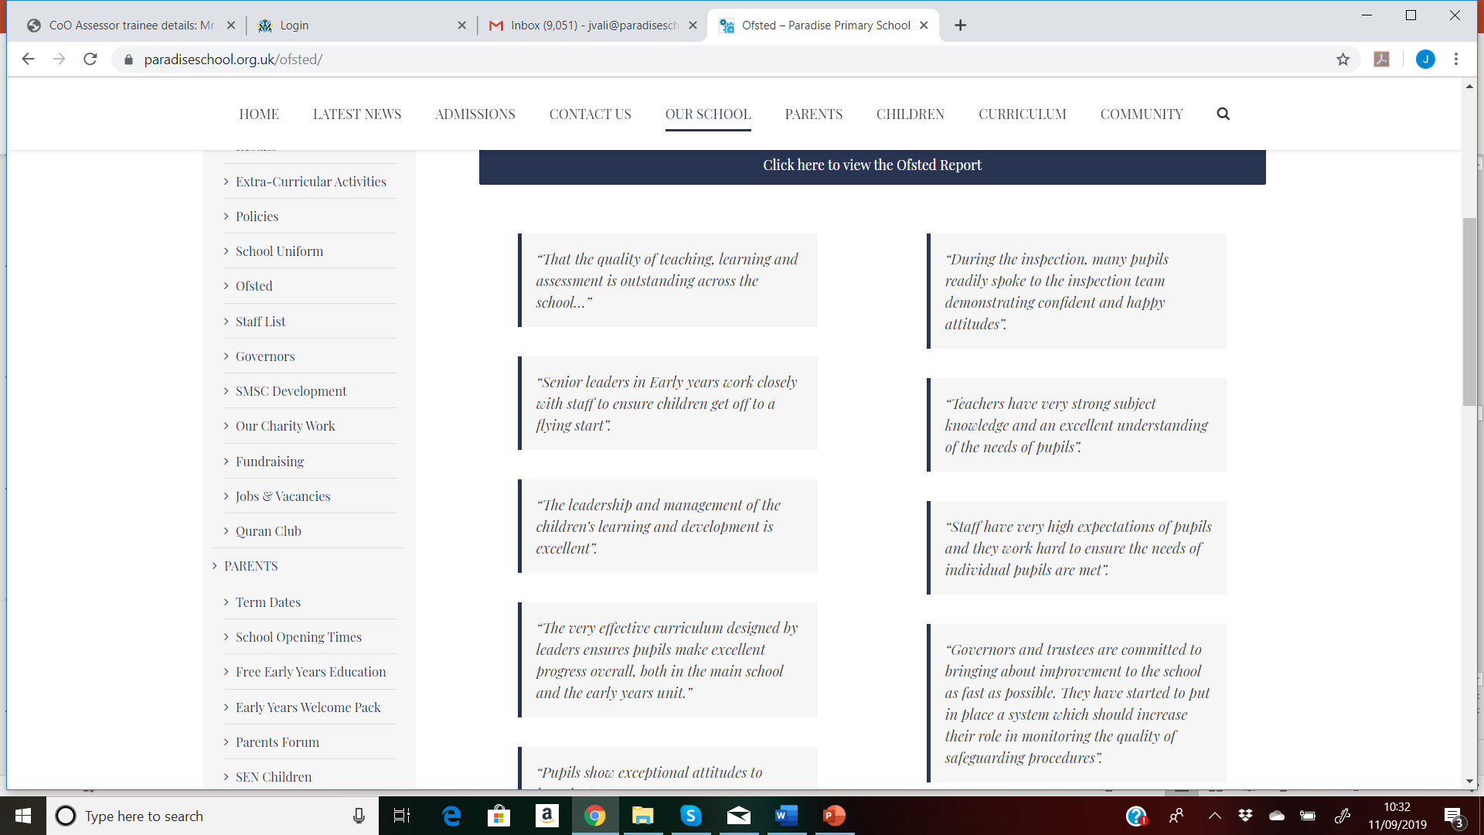
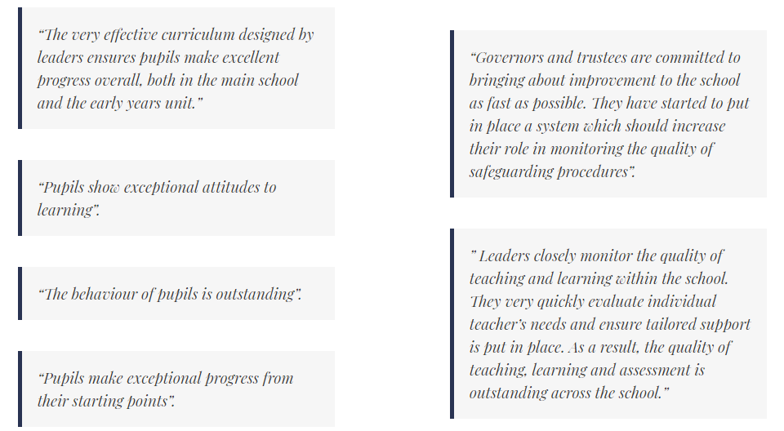
OFSTED
Our last inspection was in March 2022. The full report is available to read on our website.
Please read some of the very positive comments that were included in the most recent report

Slide 17
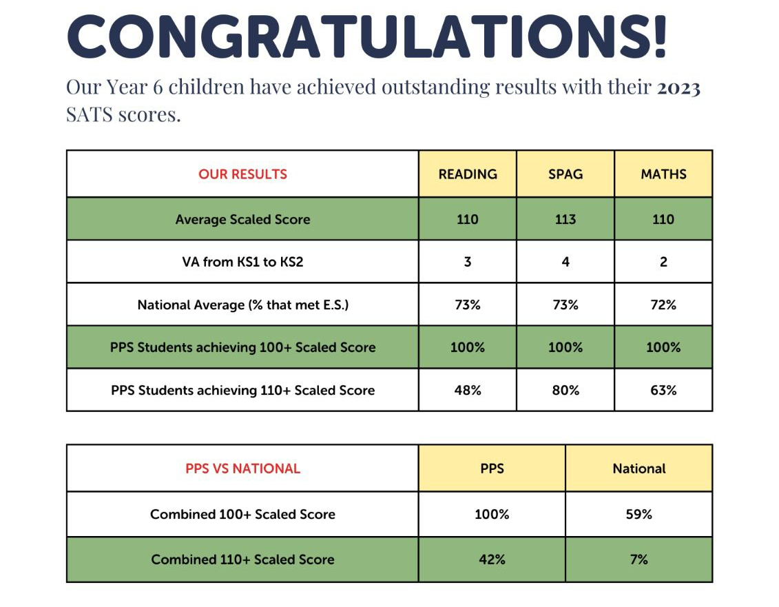
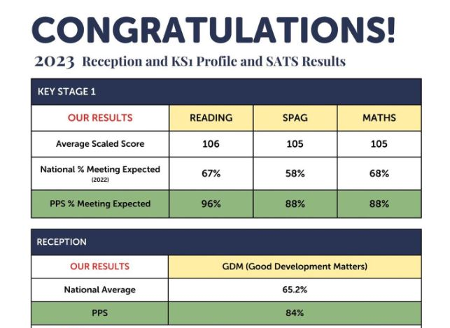
SATS Results
Paradise is consistently achieving above average results compared with the Kirklees and national averages and expectations across all Key Stages. Paradise is consistently achieving above average results compared with the Kirklees and national averages and expectations across all Key Stages.
Below are our most recent results for 2023 but please visit the website where you can view the results for previous years also. https://paradiseschool.org.uk/results/

Slide 18
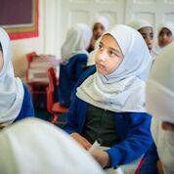
Absence and Holiday
If a child is absent you need to telephone the school before 8.45am. If a child needs to visit the dentist, doctor or hospital etc. during school hours, then the school must be informed in writing. The child will only be allowed to leave the school with their parent/guardian. If for some reason someone else is going to collect your child, the school should be informed in advance. When a child returns to school an absence note must be sent explaining the absence for our records. Parents collecting from the school building are asked to keep all children (including siblings) under close supervision at all times.
Late attendance has a detrimental effect on a child’s
personal development. Children commence group activities/ circle time and assemblies, 5 minutes after session times begin; therefore late arrivals are disruptive and effect the education of the whole class.
Parents are requested to ensure that children do not take additional holidays over and above the school holiday period. If you are considering a holiday during term time, before booking any flights etc please refer to our ‘Holiday Policy’ on the school website or request to view this in the school office. The school vehemently disapproves of holiday requests during term time due to the potential negative impact that any absence can have on a child's academic progress.

Slide 19
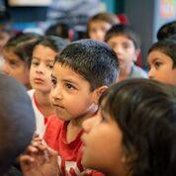
Food and Drink
There is also a school tuck shop which operates during break time on Tuesdays, for Years 1 – 6 only.
Facilities are provided for children who bring packed lunches. A packed lunch should be brought in a labelled box together with a drink in an unbreakable container with a straw or a cup. We have a healthy eating policy, to encourage the children to adopt a healthy diet.
Presently we do not have internal facilities to provide hot lunches for children but do allow parents
/ caterers to bring hot lunches to the school for the children.
Parents wishing to send hot-meals should deliver the meal to the school at the main reception entrance, between 11.40am – 11:50pm.
The school will be providing milk for children in Early Years and Years 1 and 2. We receive funding for children aged 3-5 for milk. Children over the age of 5 (not receiving Nursery Education Funding) will need to pay for the milk.
Please do not send;
Fizzy drinks, sweets, biscuits, crisps or chocolates
Jam/ chocolate (e.g. nutella) or peanut butter sandwiches in their lunches.
The School emphasises on the Islamic etiquette of eating, and would appreciate it if this teaching could be consistent in the child’s day at home and school.

Slide 20
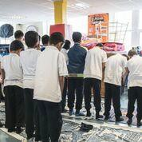
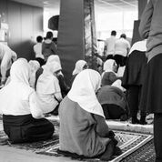
Prayers
Salaah is an integral part of the school day for all pupils, and prayers falling within the school day are said in Jamaat (congregation) on the school premises. Observance of Islamic manners, etiquette and culture are all considered as part of the daily life and add to the holistic development of our children.

Slide 21
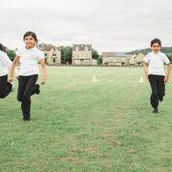
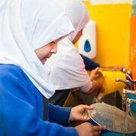
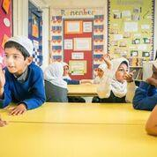
Health and Welfare
If a child is ill at school, we will make them as comfortable as possible and contact the parent/guardian. Although staff duties do not include the administering of medication, where necessary, the class teacher will assist medication. The medication should be clearly labelled and handed into the office, where the parent/guardian will be required to complete a form regarding permission, dosage and timings. Verbal instructions will not be accepted. It is the duty of the parent/guardian to remember to hand in the medication at the office at the beginning of the day and to take it at the end of the day.

Slide 22
School Times
PRIMARY TIMINGS
Key Stage 1 | 8.30am-3.00pm
Key Stage 2 | 8.30am-3.00pm
EARLY YEARS TIMINGS
Reception | 8.50am-2.50pm
Nursery Class 2 Morning | 8.30am-11.30am
Nursery Class 2 Full Day | 8.30am-2.30pm
Nursery Class 1 Afternoon | 12.15pm-3.15pm

Slide 23
Uniform
The school uniform is compulsory for all children attending full-time Reception – Year 6.
Girls
-White Burkhi
-Long sleeved white blouse
-Grey plain pinafore (knee length or over)
-Royal blue cardigan with Paradise school logo
-Ready-made grey trousers. Reception-Year 2, girls will also have the option of thick dark grey tights or leggings
-Black socks
-Black sensible shoes
-Royal blue schoolbag with Paradise school logo
Boys
-White cap
-White polo shirt
-Grey trousers
-Royal blue sweatshirt with Paradise school logo
-Black socks
-Black sensible shoes
-Royal blue schoolbag with Paradise school logo
Please ensure that the trousers are above ankle length
Schoolbags
Reception and key stage 1 (years 1 to 3) – handheld schoolbag Key stage 2 (years 4 to 6) – shoulder strap schoolbag

Slide 24
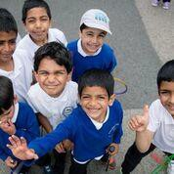
Uniform
Uniform Shop
More information is available on the website but Hair Cuts for your information the uniform can be
The following haircuts are not allowed:
To shave some parts of the head and leave other parts unshaved e.g. mohican, flattops, fades, mullets, crew cuts.
Short back and sides or step.
Lines cut into any part of the hair including sideburns.
sourced from Smart Uniforms, Batley or Asda.
It is essential all items of clothing are clearly labelled with the name of the child and class, including outdoor clothing.
Jewellery & Makeup
Please can you make sure your child is not wearing any jewellery to school - only studs are allowed due to health and safety reasons.
Valuables should not be brought into school.
Any sort of makeup is not allowed in school
e.g. kajal or eyeliner.

Slide 25
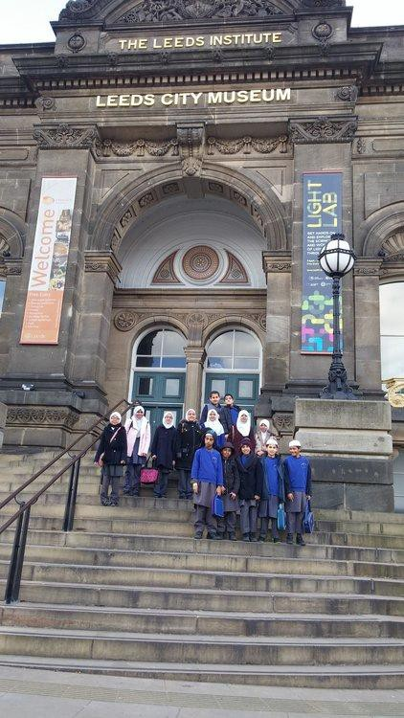
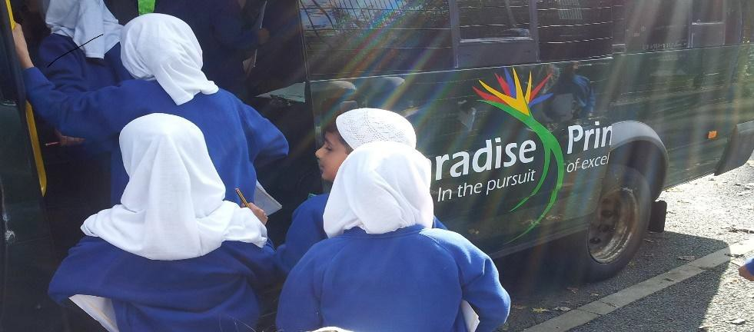
School Visits and Trips
School visits will take place during school time to support topics being taught in school. If the visit is outside the vicinity of the local area then permission will be sought prior to the trip. An annual consent form will be signed by the parents/guardians at the beginning of the school year for visits within the local environment.
Trips are included in the school fees and we aim to provide 2 educational trips per year to each year group. Sufficient notice of these trips will be provided to parents by letter.

Slide 26
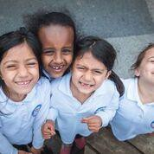
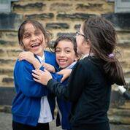
Parental Engagement
Our school community is made up of children, parents, teachers, support staff and governors. Everyone has their part to play and this brings with it certain responsibilities.
The partnership between school and parent is of great importance. If children are to fulfil their potential and benefit from their time spent in school, it is essential that there is close co-operation between school and home.
Of course, parents can contact the school at any time to discuss child’s progress and how the parent can aid the learning of the child and we encourage parents to do so.
We aim to communicate with parents in the following ways:
Class Dojo
Regular parent workshops
Termly reviews
End of year reports
Parent forum

Slide 27
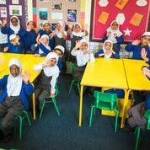
Behaviour
Bullying and the use of bad or rude language will not be tolerated, nor will any other anti-social behaviour.
Our aims and ethos are reflected by the cultivation of respect for all and by a substantial programme of investment in pastoral pupil care whereby we have a behavioural system that is based on the values of justice, forgiveness and responsibility, and which encourages ethical and emotional growth, and development in children, staff and parents / carers.
We take seriously inappropriate behaviour by any child towards other children, members of staff and the setting. Children need to learn to consider the views and feelings, needs and rights of others and the impact that behaviour has on those around them.
Parents are expected to take responsibility for their children’s behaviour and we encourage two way communications with parents so that together we encourage and nurture children.

Slide 28
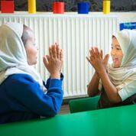
Rewards and Sanctions
The school runs a very successful rewards scheme which was chosen in conjunction with our school council. Stars are awarded for good behaviour and achievements on a classroom rewards chart and these can be redeemed in our “Rewards Shop”.
There are also opportunities for fun trips for children with significant and consistent rewards.
When the behaviour is not positive then sanctions are used to encourage good behaviour rather than punishing bad behaviour.
In case a pupil is involved in a serious misbehaviour which causes grave concern, then the pupil may receive a suspension letter or his/her parents will be called to the school in order to discuss the problem, and a suspension period will be given if necessary.
This depends on the circumstances and the type of incident caused by the child.
Due to the high level of pastoral care and strong ethos of our school serious incidents of behaviour are not common in our school but nevertheless if they occur we will take them seriously.
Verbal warning
Negative comments in planner 3 Further comments in planner
4 Written explanation of behaviour 5 Isolation
Suspension (1-5 days depending on severity of incident) at the discretion of governing body
Permanent exclusion (decision made by governing body)

Slide 29
Classroom code of conduct
•
•
•
•
•
•
•
•
•
•
•
•
•
•
•
I shall enter the classroom with the greeting ‘Assalaamu alaykum’. I will not come late to lesson.
If I am late I will knock on the door and wait for a response. I shall enter the classroom sensibly and quietly.
I prepare my books and equipment and follow instructions to start the lesson promptly. I will always work to the best of my ability without disturbing others.
I will show good manners and listen carefully when the teacher or another person is talking.
I will follow instructions immediately without comment or argument – first time, every time. I will put my hand up and wait for permission to speak.
I will take responsibility for my work and behaviour.
I will treat my school environment and others in the classroom with respect. I will seek the teacher’s permission before leaving the classroom.
I will not chew or eat anything in lesson
I will ensure the classroom is left tidy.
I WILL LEARN TO LISTEN AND LISTEN TO LEARN.

Slide 30
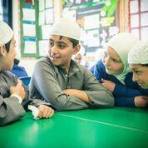
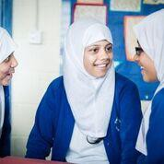
Around School Rules
Be polite and show respect for other people. Wear correct uniform at all times.
Look after property and put litter in bins.
Eat and drink in the right place at the designated time. Walk around the school sensibly and quietly.

Slide 31

Concerns / Complaints / Feedback
If you have any concerns about your child’s education and welfare at the School, please do not hesitate to contact the head teacher. Feedback is also welcomed at all times via email, comments box in school and/or communication via School Reception.
www.paradiseschool.org.uk
info@paradiseschool.org.uk

